Slide 1
COVID-19 Prediction by Big Data
Team #1 Chong Fan & Shuyan Wang

Slide 2
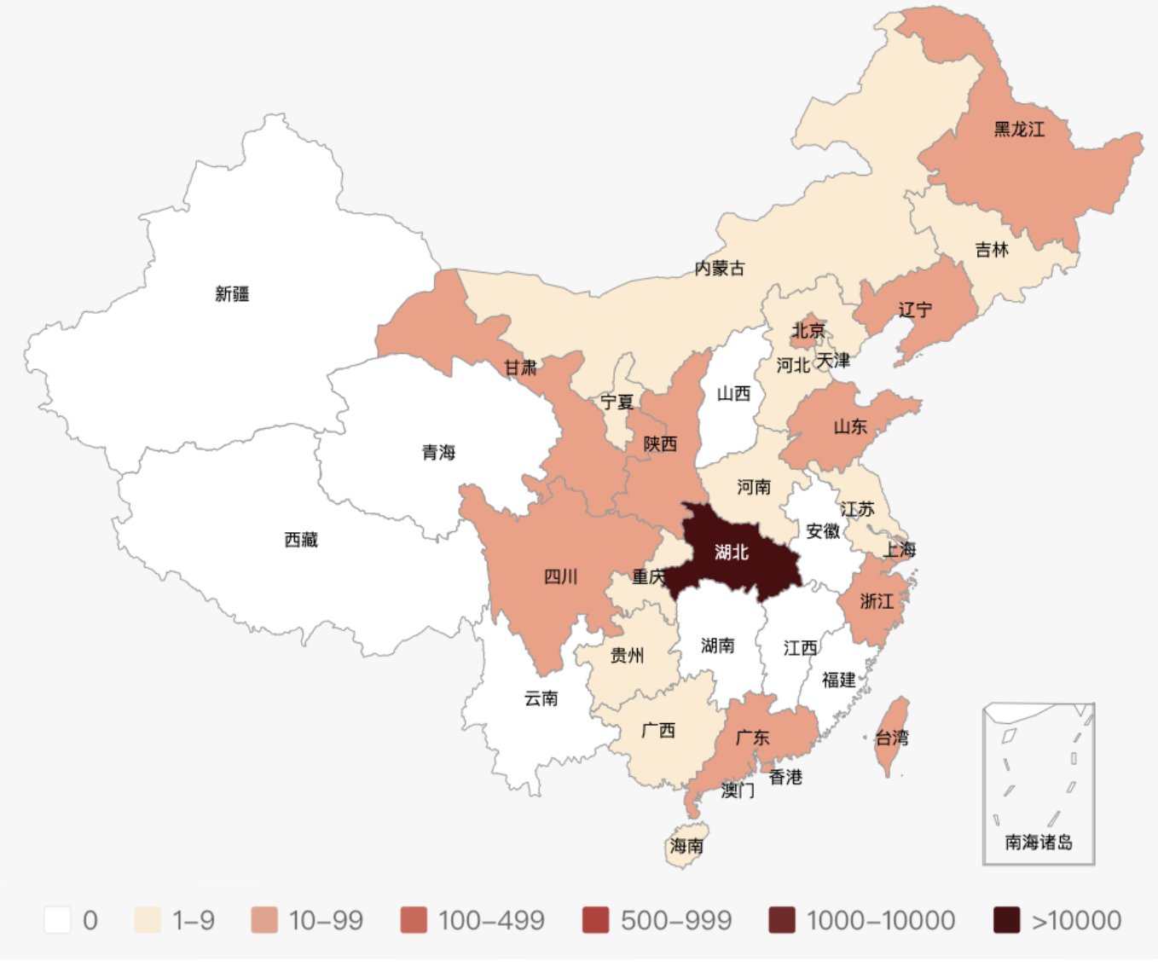
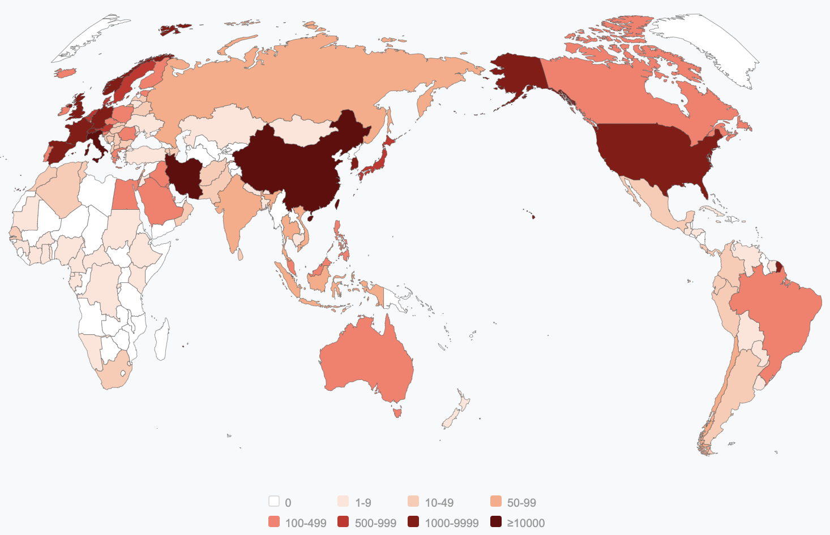
Overview
Training
Prediction
Jan 2020 - now
Mar 2020 - future
source: National Health Commission of the People’s Republic of China
source: WHO

Slide 3
Hypothetical customers
Healthcare System
source: theepochtimes.com

Slide 4
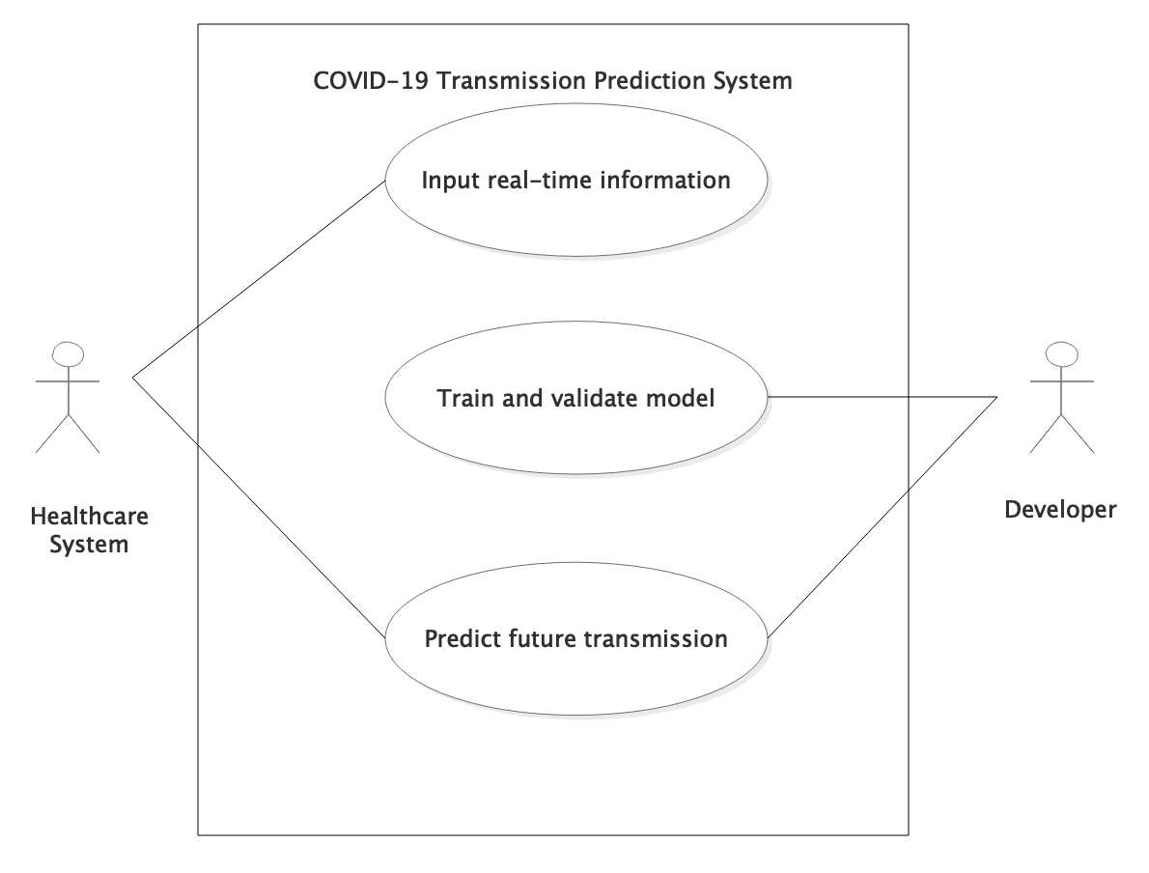
Use Case

Slide 5
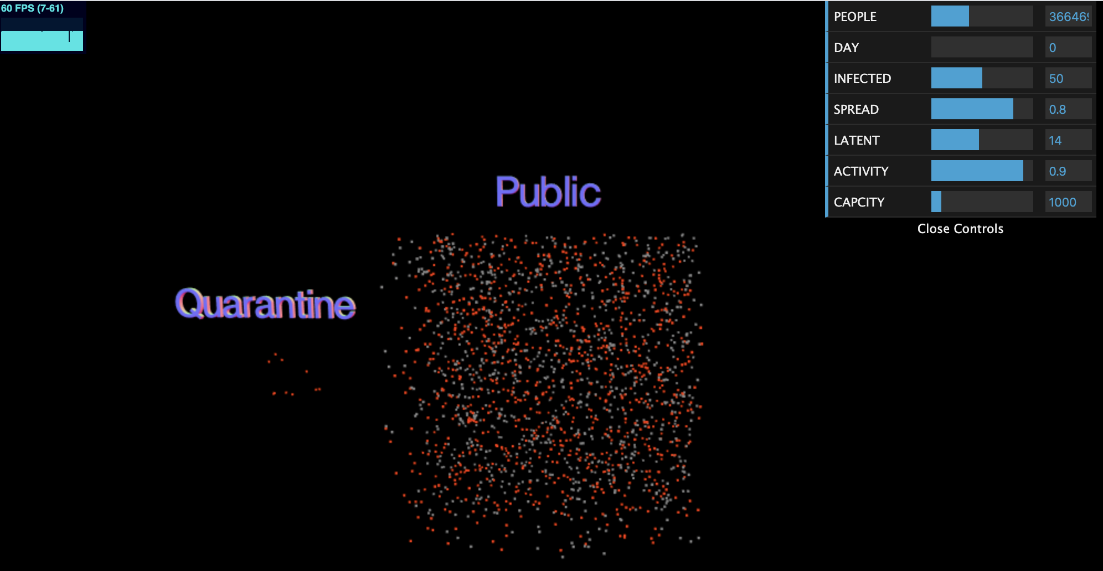
Methodology
Susceptible
Infectious
Capacity
Recovered
Health

Slide 6
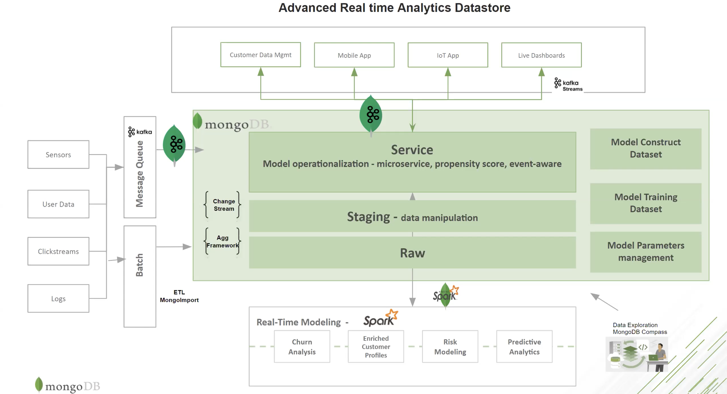

Methodology
Tencent Cloud Server
MongoDB Charts

Slide 7
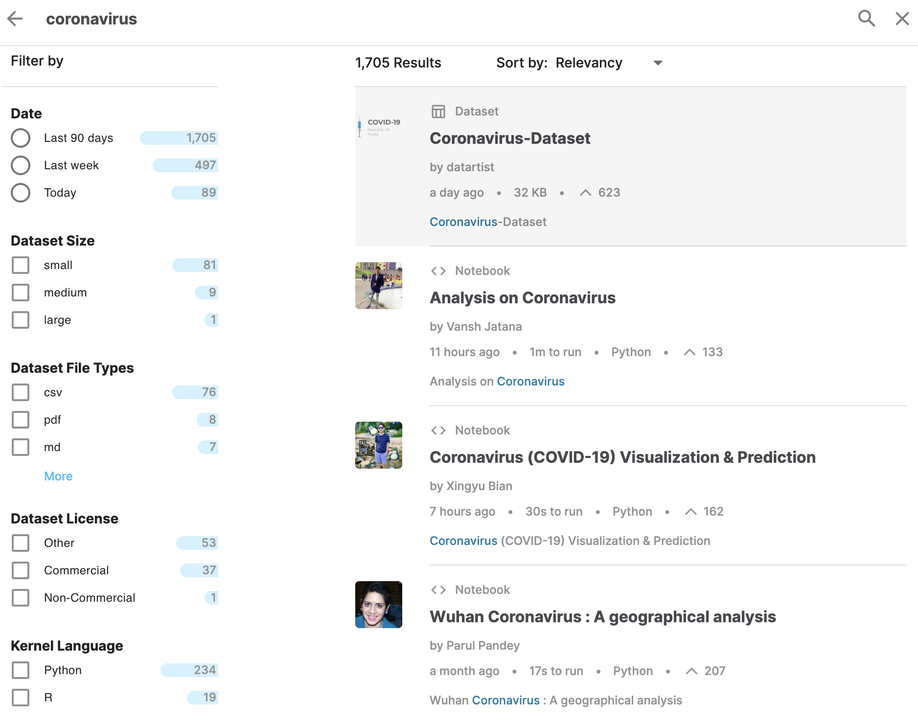
Data Source
Kaggle.com
WHO
National Health Commission of the People’s Republic of China
rows > 100,000

Slide 8
Milestones
Set up cloud server
Extract,
Transform,
& Load
Analyze
Validate & Write report
Mar 16 ~ Mar 22
Mar 30 ~ Apr 8
1
2
3
4
Mar 23 ~ Mar 29
Apr 9 ~ Apr 16

Slide 9
Scala
Fully developed by Scala
GitHub: https://github.com/ShuyanWang1996/CSYE7200project

Slide 10
Acceptance Criteria
Mean squared error is less than 60% confirmed case.
Mean absolute error is less than 60% confirmed case.
Root mean squared error is less than 60% confirmed case.
R square is between 0.4 and 1.0.
Queries can be performed in 0.5 second.

Slide 11
Goals
Number of cases daily
Health care system capacity
Time since first case

